Slide 1
DIABATES PREDICTION
DATA SPLITTING,
MODEL BUILDING,
HANDLING IMBALANCED DATASET
ANALYSIS
SRUTHI.S
2019506098

Slide 2

SPLITTING THE DATASET
Train Dataset: Used to fit the machine learning model.
Test Dataset: Used to evaluate the fit machine learning model.
The objective is to estimate the performance of the machine learning model on new data: data not used to train the model.
The scikit-learn Python machine learning library provides an implementation of the train-test split evaluation procedure via the train_test_split() function.
Common split percentages include:
Train: 80%, Test: 20%
Train: 70%, Test: 30%

Slide 3
LOGISTIC REGRESSION
It is basically a supervised classification algorithm to find the probability of dependent variable.
Logistic regression is usually used for Binary classification problems. Binary Classification refers to predicting the output variable that is discrete in two classes.
a classification problem, the target variable(or output), y, can take only discrete values for given set of features(or inputs), X.
Types : Simple Logistic Regression, Multiple logistic regression

Slide 4
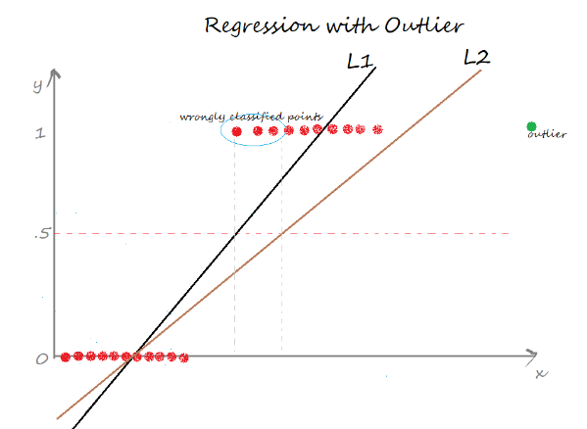
WHY NOT LINEAR REGRESSION FOR CLASSIFICATION PROBLEM?

Slide 5
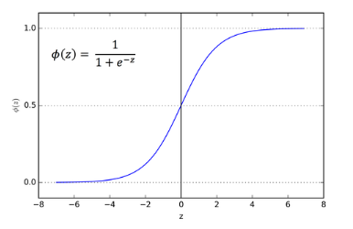
How does Logistic Regression Works?
It uses sigmoid function. It is useful to map any predicted values of probabilities into another value between 0 and 1.
A linear equation (z) is given to a sigmoidal activation function (σ) to predict the output.
It is an S-shaped curve that can take any real-valued number and map it into a value between 0 and 1
In logistic regression, the output is always a probability value between 0 or 1.

Slide 6

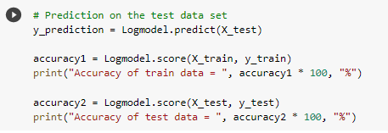

Implementation
Here we use scikit-learn library for implementing logistic regression.
First we have to create Logistic Regression classification object.
Next we have to fit the model with training data
Then we have to predict the model on test data.
Accuracy is calculated.

Slide 7

SUPPORT VECTOR MACHINE
It is one of the supervised machine learning algorithm.
Hyper-plane is a decision boundary which is constructed such that the distance between data points closest to hyper-plane in each class is maximum.
Support vectors: SVM algorithm finds the closest point of lines from both the classes. These points are called support vector and they pass through the marginal plane.
The hyper-plane with maximum margin is called optimal hyper-plane.
The main goal of SVM is to maximize the margin.

Slide 8
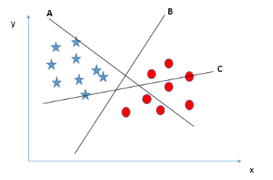
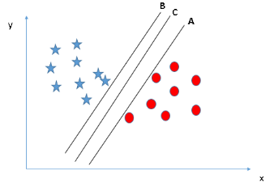
HOW SVM WORKS?
Choose the optimal hyper plane.

Slide 9
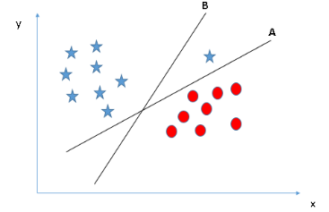
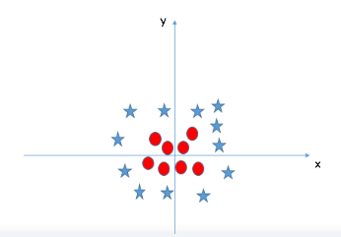

Slide 10

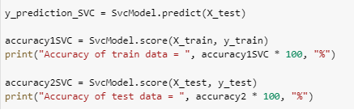
Implementation
Here we use scikit-learn library for implementing SVM.
First we have to create SVM classification object.
Next we have to fit the model with training data
Then we have to predict the model on test data.
Accuracy is calculated.

Slide 11
HYPER – PARAMETER TUNING
Hyper parameter tuning is choosing a set of optimal hyper parameter for learning algorithm.
Hyper parameters cannot be learned directly from the training process.
It is a model argument whose value is set before learning process begins.
It controls over-fitting and under-fitting of the model. Optimal hyper parameters often differ according to the dataset.
Not all model hyper parameters are equally important. It is desirable to select a minimum subset of model hyper parameters to search because more hyper parameters of an algorithm that you need to tune, slower the training process.
Different models have many hyper parameters, for finding the best combination of parameters, we have 2 methods namely:
GridSearchCV
RandomizedSearchCV

Slide 12
GridSearchCV & RandomizedSearchCV
In GridSearchCV approach, machine learning model is evaluated for a range of hyper parameter values. This approach is called GridSearchCV, because it searches for best set of hyper parameters from a grid of hyper parameters values.
Drawback : GridSearchCV will go through all the intermediate combinations of hyper parameters which makes grid search computationally very expensive.
RandomizedSearchCV solves the drawbacks of GridSearchCV, as it goes through only a fixed number of hyper parameter settings. It moves within the grid in random fashion to find the best set hyper parameters. This approach reduces unnecessary computation.

Slide 13
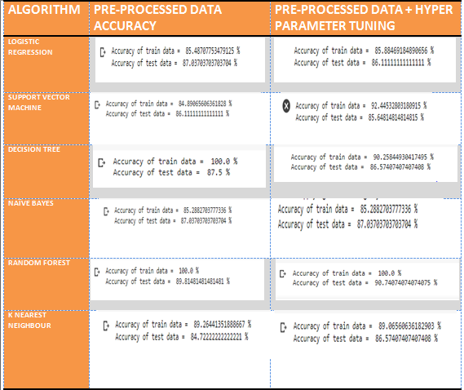
AFTER PERFORMING HYPER PARAMETER TUNING

Slide 14

IMBALANCED DATASET
After performing outlier removal we have 719 records out of which 477 are non diabetic record and remaining 242 records are diabetic record.
Imbalanced dataset may results in poor predictive performance, specifically for the minority class.

Slide 15
HANDLING IMBALANCED DATSET
Undersampling
When there exists a class that is in abundance, under sampling aims to reduce the size of the abundant class to balance the dataset. This method is used when quantity of data is sufficient. By keeping all samples in the rare class and randomly selecting an equal number of samples in the abundant class, a balanced new dataset can be retrieved for further modeling.
Oversampling
Over-Sampling increases the number of instances in the minority class by randomly replicating them in order to present a higher representation of the minority class in the sample. It often leads to over fitting of the training data.
SMOTE
Synthetic Minority Over-sampling Technique for imbalanced data
This technique is followed to avoid over fitting which occurs when exact replicas of minority instances are added to the main dataset. A subset of data is taken from the minority class as an example and then new synthetic similar instances are created. These synthetic instances are then added to the original dataset. The new dataset is used as a sample to train the classification models.

Slide 16


Slide 17
OBSERVATIONS

Slide 18
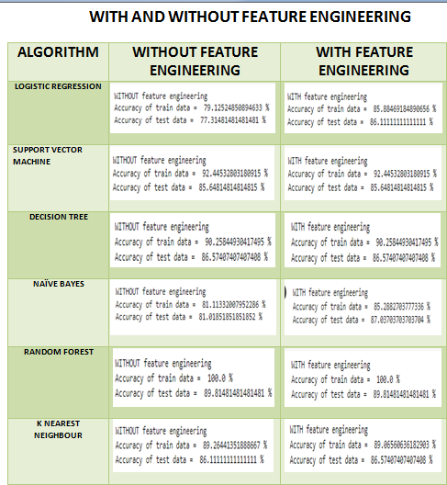

Slide 19
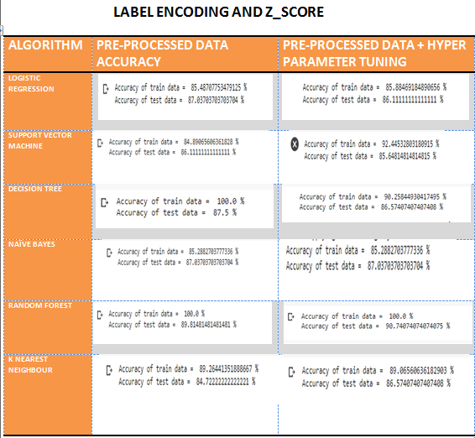

Slide 20
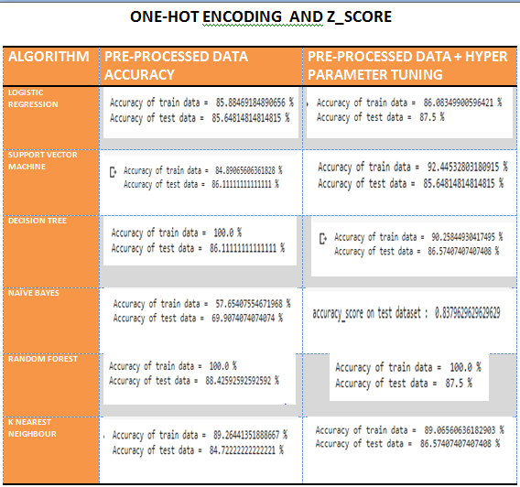

Slide 21
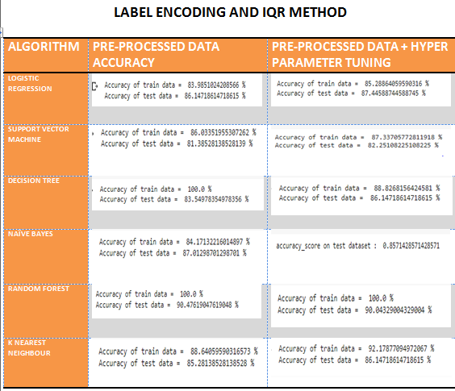

Slide 22
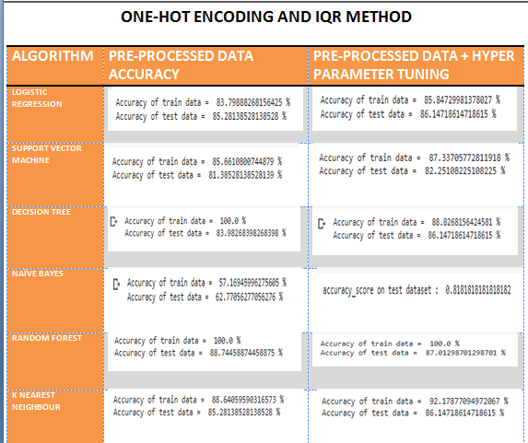

Slide 23
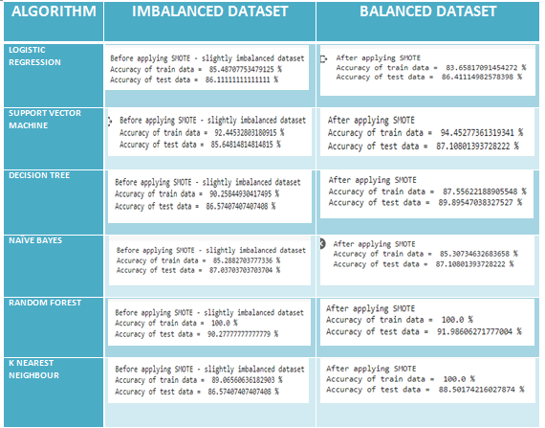

Slide 24
OBSERVATIONS DONE:
After performing feature engineering the accuracy of logistic regression and naïve bayes has been improved. For other 4 algorithms there is no impact by feature engineering as the accuracy remains the same.
For outlier removal Z score is used and for converting categorical variable to numeric variable we use label encoding because this combination gives higher accuracy for most of the algorithms that we have used.
Hyper parameter tuning increases the accuracy for most of the algorithms like SVM, NB, RF, KNN.
After performing synthetic minority over sampling technique (technique to handle imbalanced dataset) accuracy have been improved.
Highest accuracy has been achieved for Random forest algorithm with 91.98% for testing data.
We have almost increased the accuracy from 5% to 10% according to the algorithm.

Slide 25
ACCURACY COMPARISION WITH PAPERS
ALGO | Aishwarya et al | Deepti et al | Muhammed et al | Priyanka et al | Sivatanjini et al | OUR PAPER
LR | 76% | - | 74% | - | - | 86.411%
SVM | 68% | 65.10% | 77% | 77.3% | 81.4% | 87.10%
DT | 74% | 73.82% | 71% | 85% | - | 89.89%
NB | 67% | 76.30% | 74% | 77% | - | 87.10%
RF | 72% | - | 71% | - | 83% | 91.98%
KNN | 72% | - | 77% | - | - | 88.50%

